Slide 1
Understanding thermal distribution in
semiconductor devices by simulation
Marzuk Kamal

Slide 2
What do we learn from thermal simulation?
Air
Planner heat source
LED
P
Glass
N
z
Lead frame
y
x
Heat distribution on LEDs
Properties of the LED P-N junction as a Heat source
Other potential candidates for thermal contribution, such as, convection, and conduction from the surroundings
Improved temperature control mechanism

Slide 3
The Heat equation in 3D
u = u(x, y, z, t) , Object temperature
D = D(T) thermal diffusivity
Q = Q(t), external heat source
c = c(T) specific heat of the material
rho = material density

Slide 4
Boundary conditions
Dirichlet boundary condition
Defines fixed heat source or sink
For example having a heat sink at x = 0 wall,
u(0,x,y,t) = 0
Neumann boundary condition
Defines heat flux at the boundary
For example, zero heat transfer at y = 0 is defined as

Slide 5
Thermal simulation on a silicon slab
Initial T = 10 C
Neumann du/dy= 0 at y = b plane
Dirichlet u = 0
c
b
a
z
y
x

Slide 6
Analytical solution

Slide 7
Analytical solution
m, n, p = harmonic modes along x, y, z , respectively
A₀ = initial temperature of the system
D = thermal diffusivity

Slide 8
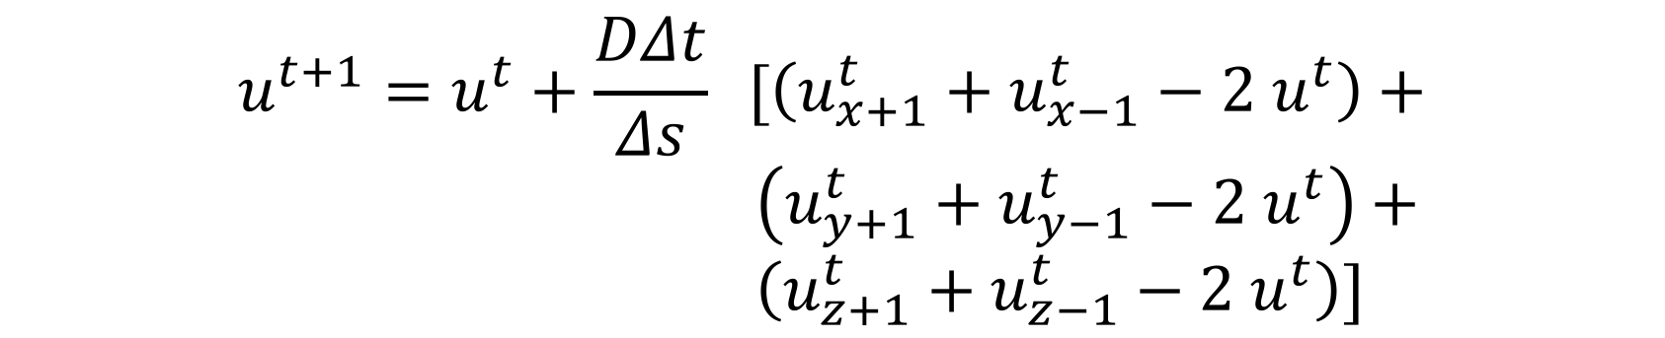
Numerical solution
$$u^{t+1}=u^{t}+\frac{DΔt}{Δs} [\left(u_{x+1}^{t}+u_{x−1}^{t}−2 u^{t}\right)+$$
$\left(u_{y+1}^{t}+u_{y−1}^{t}−2 u^{t}\right)+$
$\left(u_{z+1}^{t}+u_{z−1}^{t}−2 u^{t}\right)]$
And
D = thermal diffusivity
ds = voxel width
dt = iteration time step

Slide 9
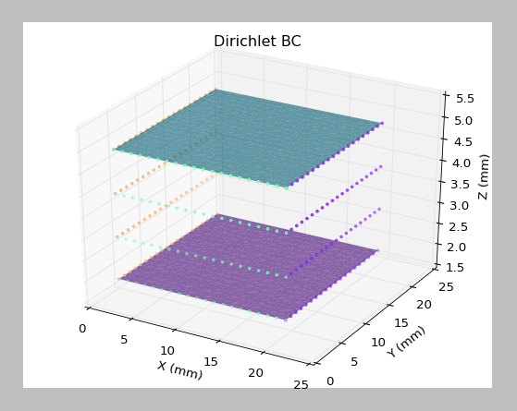
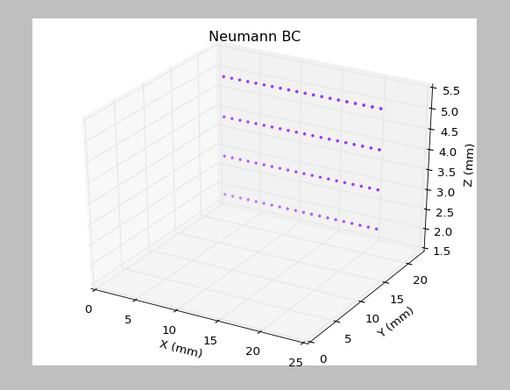
Boundary conditions

Slide 10
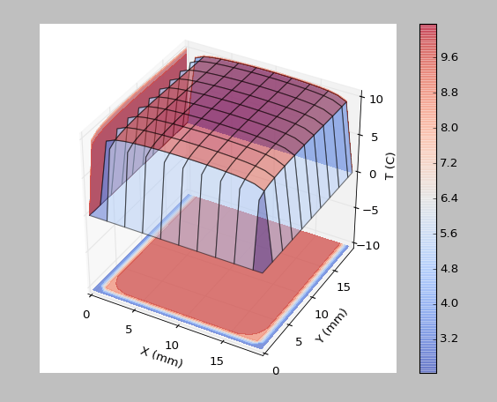
Analytic solution at t = 0, at the mid z-plane
D = 5.5e-5 m²/s

Slide 11
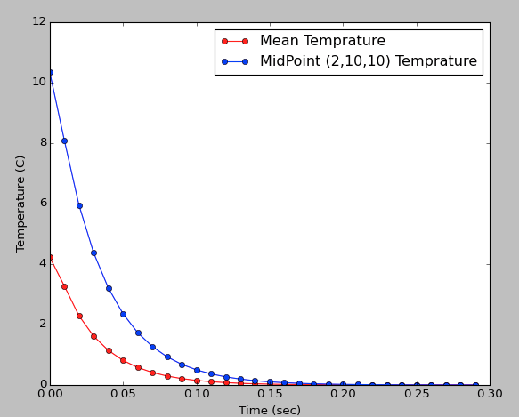
Temperature change with time (analytical solution)

Slide 12
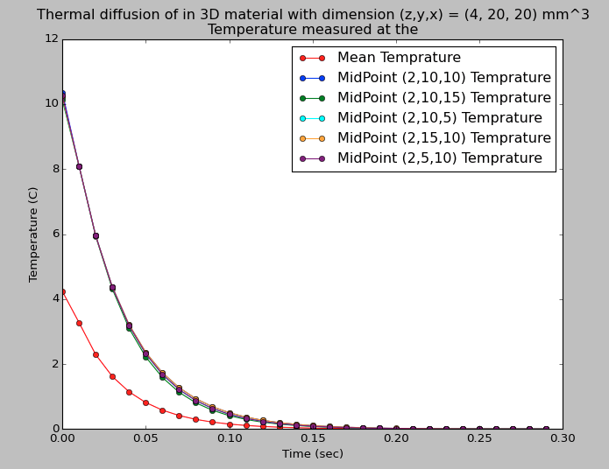
Temperature changes with time (analytical solution)

Slide 13
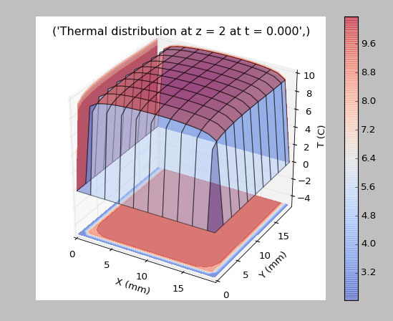
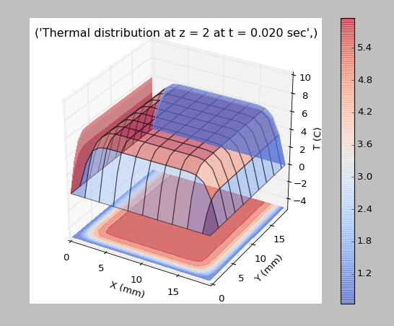
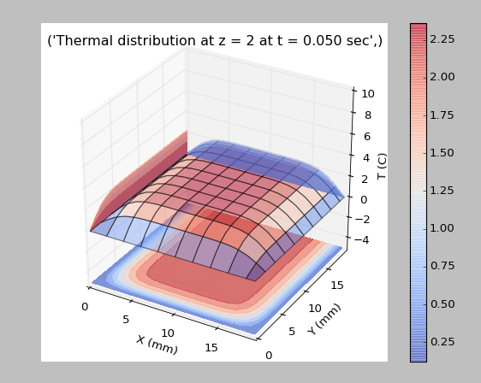
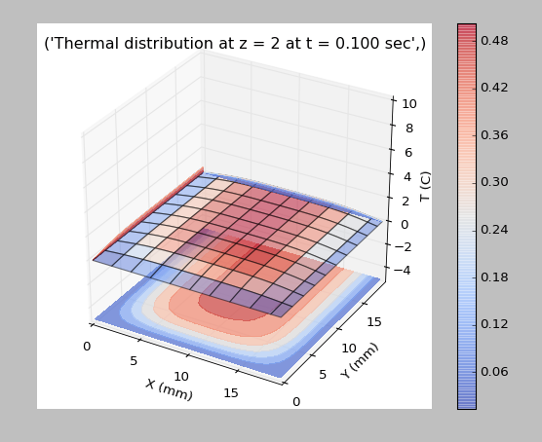

Slide 14
Numerical solution on the slab (4x20x20 mm³)

Slide 15
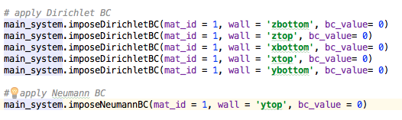
Boundary conditions

Slide 16
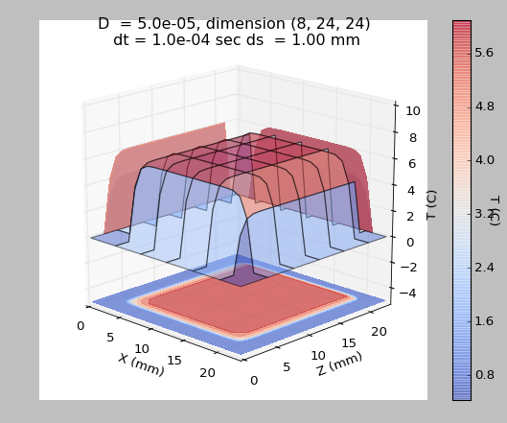
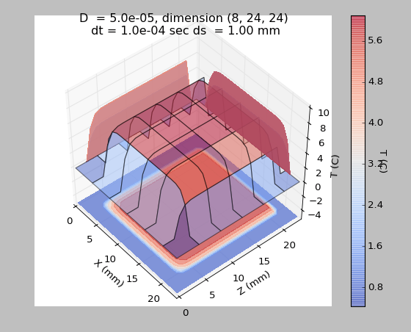
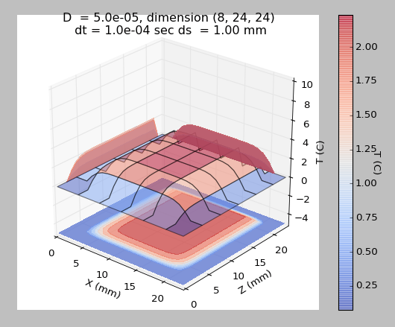
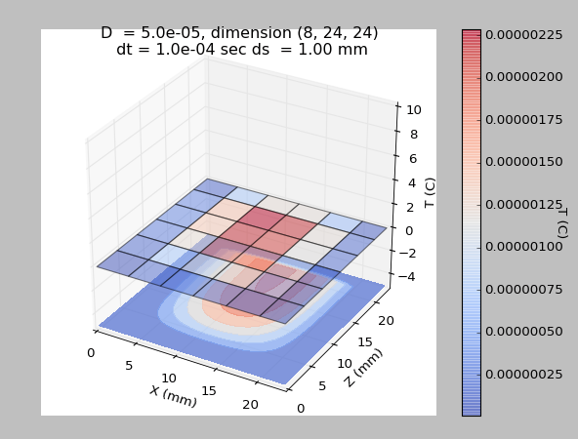
t = 5 ms
t = 10 ms
t = 30 ms
t =300 ms

Slide 17
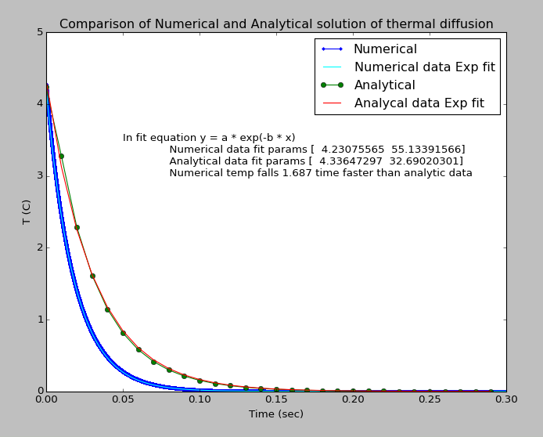
Comparison between analytical and
numerical simulation data

Slide 18
Simulation of GaAs diode with Heat generation at the P-N junction
Q is non-zero
Specific heat, c = 0.33 J/gm/C
Material density, rho = 5.32 gm/cm³
Powar density, Q = (VA * f0) per unit volume
F0 = fraction of power that is converted to heat (e.g. 0.5)
V = 2.5 V
I = 50 mA
P = 125 mW
Q = 125/2 = 62.5 mW / (Voxel volume)

Slide 19
Boundary conditions
Dirichlet T = 25 C on all the surfaces
Neumann du/dt = 0 on all the surfaces

Slide 20
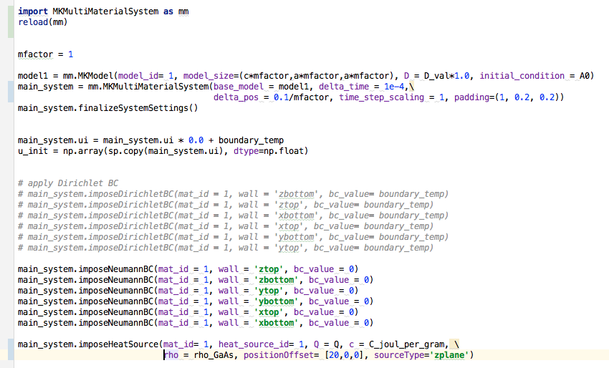

A glimpse on the simulation code

Slide 21
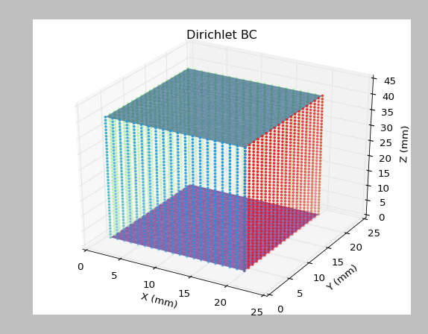
Initial temperature T=20 C All sides have Dirichlet BC at T = 25 C

Slide 22
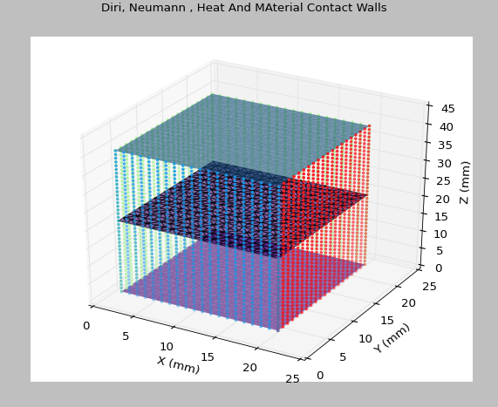
Heat source at the P-N junction
Heat source at P-N junction

Slide 23
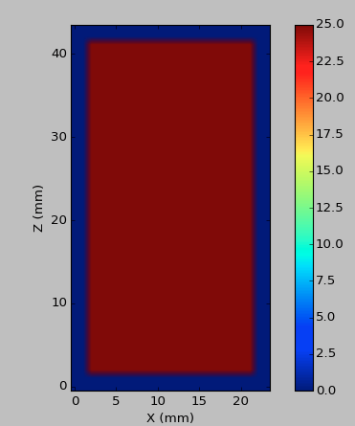
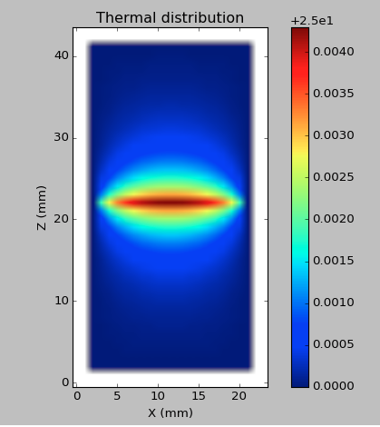
Effect of heat source on the diode after 10 second

Slide 24
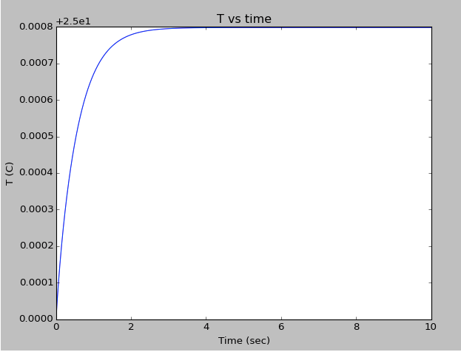
Y-section
Mean temperature of the diode vs Time

Slide 25
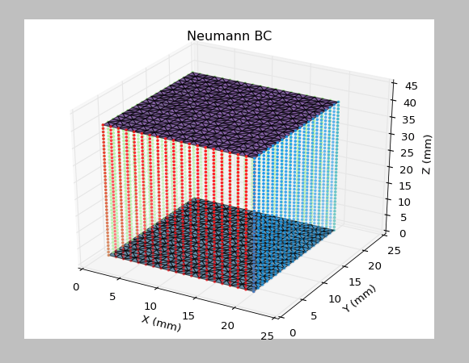
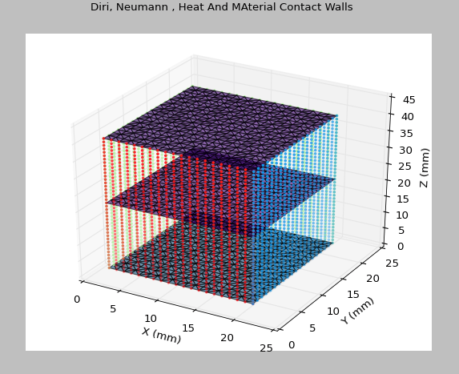
Simulation with Neumann BC du/dt = 0
Heat source

Slide 26
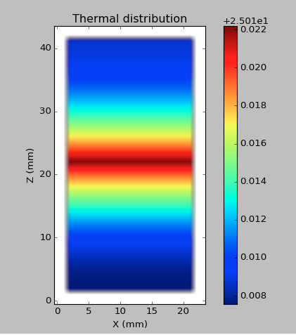
Simulation with Neumann BC du/dt = 0

Slide 27
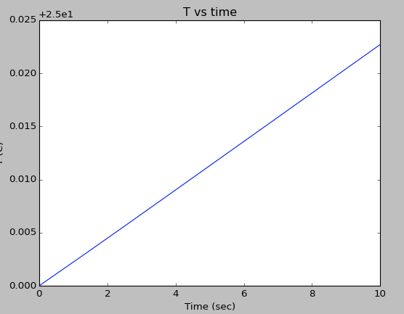
Simulation with Neumann BC du/dt = 0
Mean temperature of the diode vs Time

Slide 28
Comparison of Temp vs Time with different BC
Dirichlet BC
Neumann BC
Heat saturation
Heat accumulation

Slide 29
Temperature dependence of thermal conductivity of GaAs

Slide 30
Temperature dependence of Specific Heat of GaAs

Slide 31
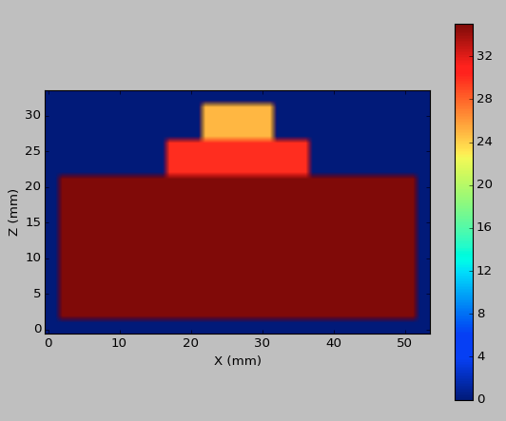
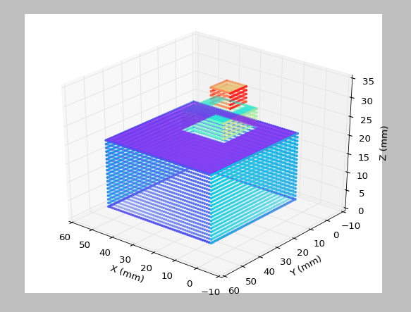
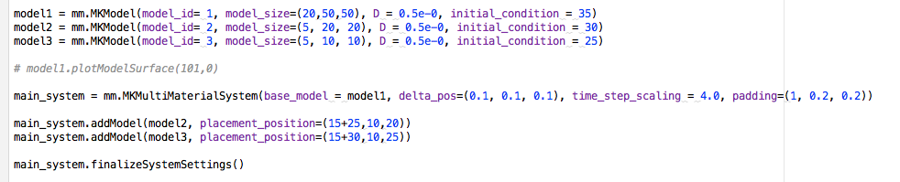
Multiple objects
Y-Section
Some issues needs to be resolved in new version

Slide 32
Next
The program is ready to do simulation on more complex systems.
Issue with the mismatch between analytical and numerical data needs to be resolved.
Specific heat, thermal diffusivity and density depends on temperature. So this extra effect will needs to incorporated in simulation.

